Slide 1
ORGANISATIONAL
BEHAVIOUR
CHAPTER-16
LEADERSHIP

Slide 2
Difference Between Leaders and Managers
Leaders Managers
Innovate Administer
Develop Maintain
Inspire Control
Long-term view Short-term view
Ask what and why Ask how and when
Originate Initiate
Challenge the status quo Accept the status quo
Do the right things Do things right

Slide 3
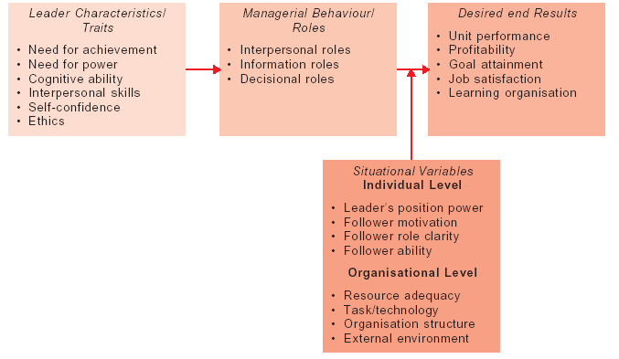
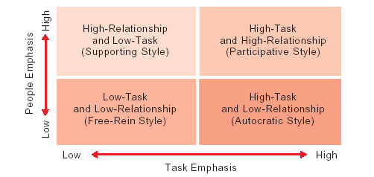
A Conceptual Framework for Understanding Leadership
Four Key Leader Behaviours

Slide 4
Successful Traits of Leaders
        (i) A strong desire for accomplishment
        (ii) Persistent pursuit of goals
        (iii) Creativity and intelligence used to solve problems
        (iv) Initiative applied to social situations
        (v) Self-assumed personality
        (vi) Willingness to accept behavioural consequences
        (vii) Low susceptibility to interpersonal stress
        (viii) High tolerance of ambiguity
        (ix) Ability to influence other people
        (x) Ability to structure social interactions

Slide 5
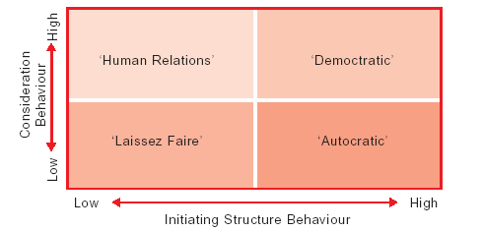
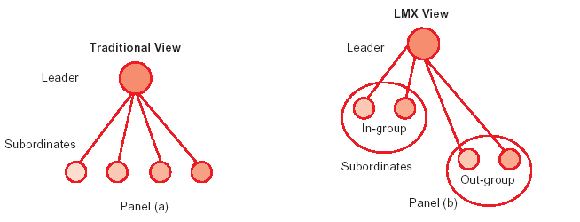
Leader Behaviours and Leadership Styles
Contrasting Views of Leader-Subordinate

Slide 6
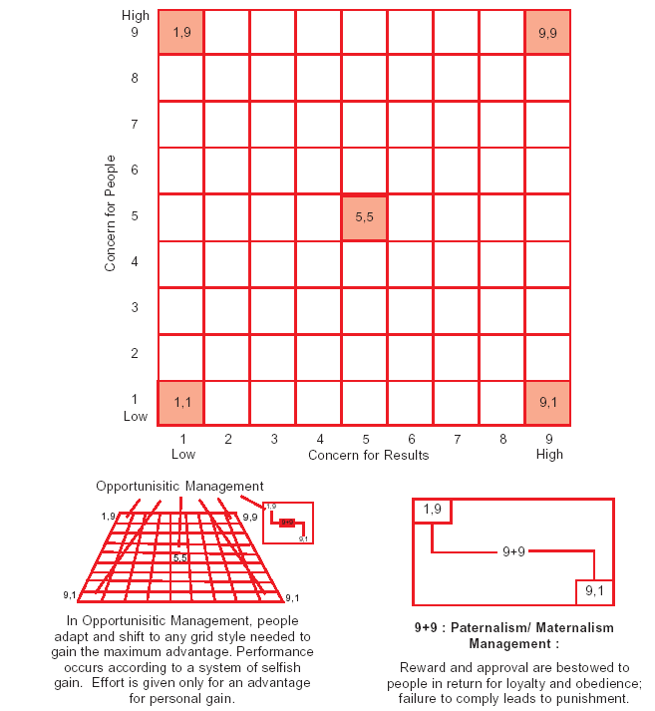
The Managerial Grid

Slide 7
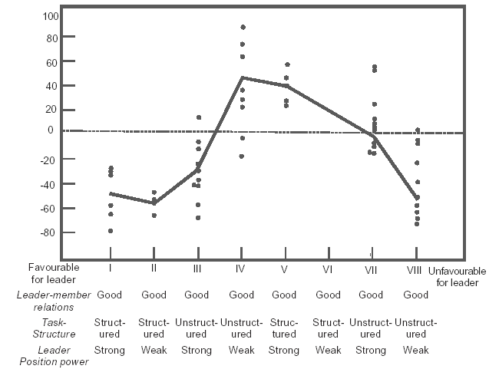
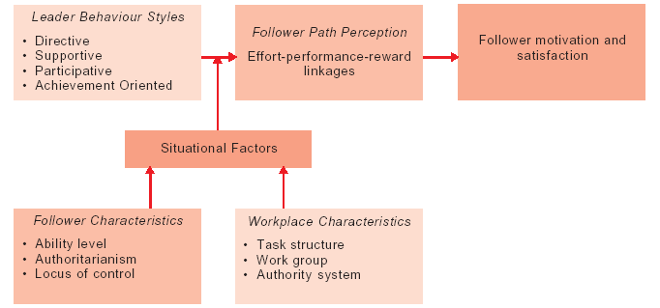
Leadership Effectivenss in the Contingency Theory
The Path-goal Theory of Leadership

Slide 8
Leader Behaviour Dimensions in Path-Goal Theory
Leader Directiveness
Letting subordinates know what’s expected.
Providing specific guidance as to what should be done and how.
Making leader’s part in the group understood.
Scheduling work to be done.
Maintaining definite standards of performance.
Leader Supportiveness
Showing concern for status and well-being of subordinates.
Doing little things to make the work more pleasant.
Treating members as equals.
Being friendly and approachable.
Leader Participativeness
Consulting with subordinates.
Soliciting subordinate suggestions.
Taking these suggestions seriously.
Maintaining definite standards of performance.
Leader Achievement-orientedness
Setting challenging goals.
Expecting subordinates to perform at their peak levels.
Showing a high degree of confidence in subordinates.
Constantly emphasising excellence in performance.

Slide 9
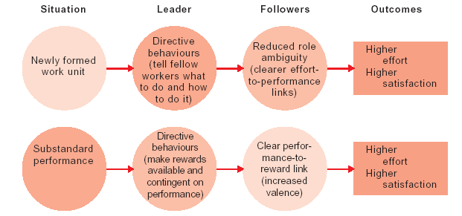
Example of Applying Path-Goal Theory

Slide 10
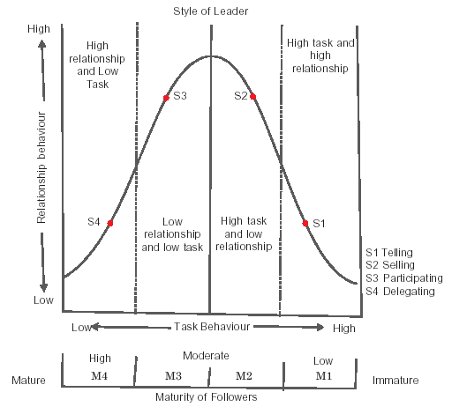
The Situational Theory of Leadership

Slide 11
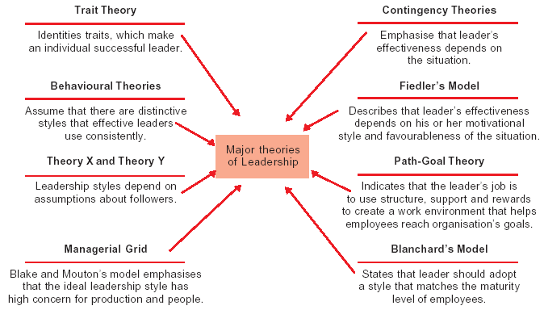
Leadership Theories

Slide 12
Situation – Style Match
Situation Recommended Leadership Style
1. People in a state of confusion or panic because of crisis High task and low relationship or
such as materials shortage, equipment failure, or authoritarian.
natural disaster.
2. Complex technology, inexperienced employees. High task and low relationship at the outset
3. Undesirable, repetitive jobs, average employees. High relationship and low task.
4. Self-sufficient, capable workers performing job. Low task and low relationship
5. Employees dislike working, job is undesirable. High relationship and high task.
6. Start-up of new operation, job descriptions are vague. High relationship and high task.
7. Group of people “doing time” until retirement. High relationship and low task.
8. Inexperienced but well meaning employees. High relationship and high task.
9. Repetitive work; employees with average motivation. High relationship and low task.
10. Employees are performing independent tasks requiring High task; emphasis on relationship coordination by leader. depends on emotional maturity of employees.
11. Emotionally immature employees; average skill level. High task and low relationship.
12. Employees are child like or “prima donnas” but talented. High relationship and low task.

Slide 13
Behavioural Components of Charismatic and Non- Charismatic Leaders
Non-charismatic Leader Charismatic Leader
Relation to Status Quo Essentially agrees with status quo Essentially opposed to status quo and and strives to maintain it strives to change it
Future Goal Goal not too discrepant from status Idealised vision which is highly discrepant quo from status quo
Likableness Shared perspective makes him/her Shared perspective and idealized vision likable makes him/her a likable and honourable hero worthy of identification and imitation
Trustworthiness Disinterested advocacy in persuasion Disinterested advocacy by incurring great attempts personal risk and cost
Expertise Expert in using available means to Expert in using unconventional means to
achieve goals within the framework of transcend the existing order
the existing order
Behaviour Conventional, conforming to existing Unconventional or counter normative norms
Environmental Sensitivity Low need for environmental sensitivity High need for environmental sensitivity for
to maintain status quo changing the status quo
Articulation Weak articulation of goals and Strong articulation of future vision and motivation to lead motivation to lead
Power Base Position power and personal power Personal power (based on expertise,
(based on reward, expertise and respect and admiration for a unique hero)
liking for a friend who is a similar other)
Leader-Follower Egalitarian, consensus seeking, or Elitist, entrepreneur and exemplary.
directive. Nudges or orders people to Transforms people to the radical changes
share his/her views advocated

Slide 14
Summary
        Leadership refers to the process of influencing others to follow enthusiastically towards realisation of shared goals. Influence is a two – way process. The leader influences and is influenced by followers.
        Leadership is important to commit a group of people towards specific goals and to make use their potentials to realise the goals. Leadership has the ultimate aim of raising the level of human conduct and the ethical aspirations of people.
        There is talk about formal leadership and informal leadership. Formal leadership occurs when a manager leads by exercising formal authority. Informal leadership arises when a person without formal authority is influential in directing the behaviour of others.
        Different leadership styles are distinguished. In this book leadership styles are divided into four types : (i) those that are based on the amount of authority retained; (ii) those that place relative emphasis on people versus task; (iii) those that are based on leader’s assumptions about people; and (iv) entrepreneurship styles.
        Among the theories of leadership, the most discussed theory is trait theory. According to this theory, certain characteristics make successful leaders distinct from unsuccessful ones. These qualities have been identified, though not successfully. A successful leader is said to possess biological, psychological and social qualities.
        Next in importance are the behaviour theories, which focus on what the leaders do while influencing the behaviour of subordinates. The behaviours of leaders can be acquired. Ohio State University studies and the University of Michigan studies are the research studies conducted in support of the behavioural theories.
        Contingency theories (including Fiedler’s model and the path – goal model of Robert House) stress on the fact that leadership effectiveness depends on situations and not on traits or behaviours of leaders.

Slide 15
        Situational leadership theory propounded by Paul Hersey and Kenneth Blanchard, adds a new dimension to leadership, viz., maturity. The theory hypothesises that the leader’s style depends on the maturity level of the subordinate employees.
        McGregor’s Theory X and Theory Y remind the leaders that contrary to popular belief, individuals are under Theory Y. Accordingly, leaders must adopt participative styles to influence the followers.
        The discussion of theories is highly useful to leaders in more than one way. The traits theory underlines that an individual possessing the necessary qualities must be appointed as leader.
        Behavioural theories postulate that the behaviour of leaders is more important than their qualities. These behaviours can be acquired unlike traits, which are generally inherited.
        Contingency theories emphasise that the situation in which a leader operates is the most important determinant of his effectiveness.
        Three contemporary issues on leadership should not be missed by any reader. First one relates to the need for transformational leadership and not mere transactional leadership. The second issue relates to the women as leaders. Surprisingly, women are not inferior to men in skills and abilities but the latter are generally preferred for leadership positions in our male dominated society. The third issue relates to charismatic leadership which is needed when an organisation is introducing a totally new product.

Slide 16
Key Terms
Authoritarian leadership
Contingency theory
Leadership
Least preferred co-worker
Managerial Grid
Leadership styles
Charismatic leadership
Free-rein style
Leadership match
Participative style
Transformational leadership

